Slide 1

Search for Lepton Flavor Violating Decays of the Higgs Boson in μτ_{e} Final State
Nabarun Dev
Oral Candidacy Exam Presentation 5 April 2017
Supervisor: Prof. Colin P Jessop

Slide 2
Outline of the Presentation
Introduction
Standard Model Higgs and Lepton Flavor Violation (LFV)
LHC and the CMS
CMS ECAL and Trigger system
Brief review of technical Work
Analysis overview
Signal
Backgrounds
H->μτ
Analysis overview
H->μτ_{e}
H->μτ _{h}
*Details in in talk here and backup.

Slide 3
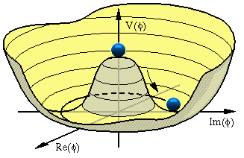
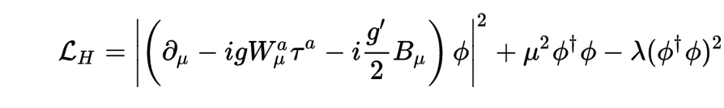
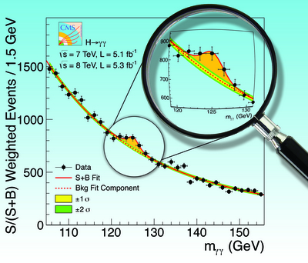
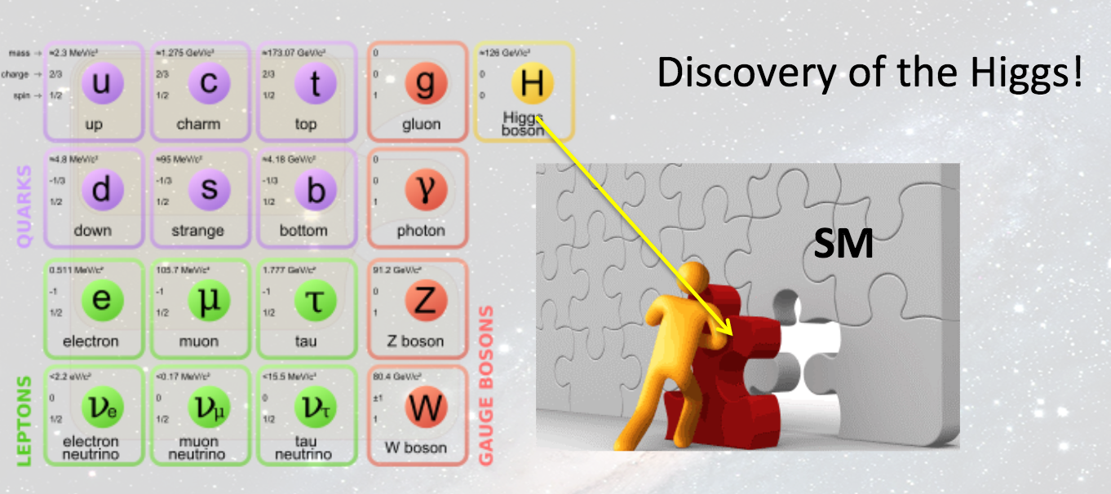
Standard Model and the Higgs Boson : I
Standard Model is the most elegant and well-tested description of nature available today.
In SM, elementary particles acquire mass from their interaction with the scalar Higgs field, the quantum of which is the Higgs Boson.
Discovered in 2012 by CMS and ATLAS experiments at CERN’s LHC
Higgs potential
After 40 years of searching!

Slide 4
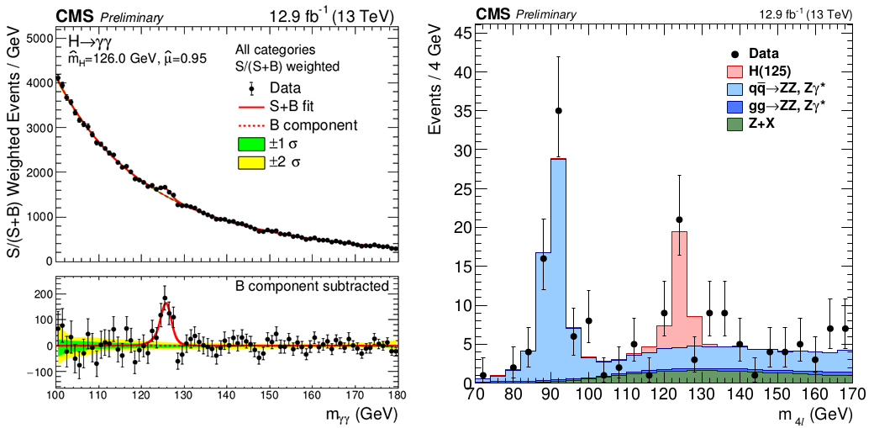
Standard Model and the Higgs Boson : II
Combined ~5σ excess observed in channels where Higgs decays to two photons or two Z bosons
Latest results from CMS experiment confirming the excess consistent with the Higgs boson
The discovery of the Higgs provides a with a portal for us to not study the processes within SM, but also to look for new physics processes beyond it (BSM).
Indeed, of the main goals of the LHC physics program at CERN is to search for such BSM processes.

Slide 5
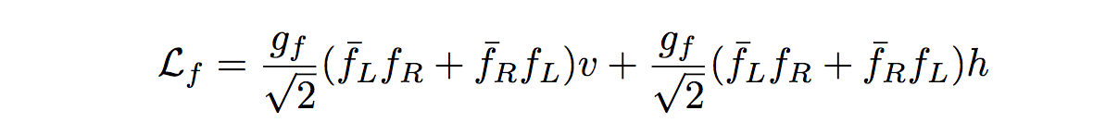
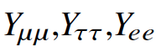
Lepton Flavor Violation and the Higgs Boson
LFV interactions between charged leptons not allowed naturally in SM
Never observed experimentally
Higgs interacts with leptons via Higgs-fermion Yukawa couplings Y_{ll}.
Mass term
Higgs-fermion coupling
Lepton Flavor Conserving terms
In the SM: the coupling matrix has only diagonal terms:
But many BSM theories allow introduction of off-diagonal couplings such as: Y_{μτ.}
Branching ratios constrained weakly by indirect searches: BR ( H→μτ )<O(10%)
This makes LFV Higgs decays a possibly exciting signature of new physics.

Slide 6
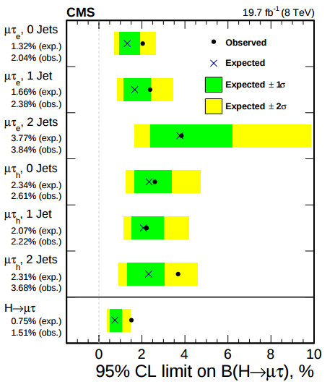
LFV Higgs: previous searches
Search performed using data collected by CMS during RUN I of LHC
2.4σ excess in the H->μτ channel was observed
Exclusion Limits improved by an order of magnitude
B(H->μτ) < 1.51% at 95% CL
Above excess does not meet the mark for claiming discovery of LFV Higgs decay
BUT warrants for a search with a larger amount of data!
36 fb⁻¹ data collected by CMS in RUN II of LHC offers us this opportunity.

Slide 7
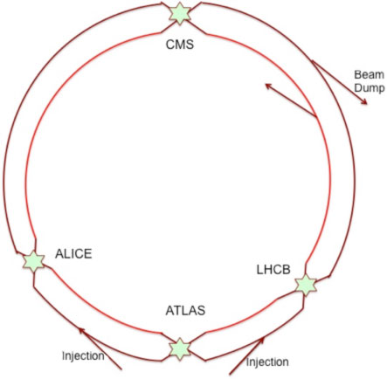
The Large Hadron Collider
Two circular beam pipes carrying protons travelling in opposite direction
Intersecting at four collision points
Beams kept on circular path using superconducting magnets
Design center-of-mass energy 14 TeV and Luminosity =10e34 cm⁻²s⁻¹
Circumference:27km 50 -175 m under ground
Current running conditions:
COM energy: 13 TeV (7 TeV in Run I)
Luminosity~1.5*10e34 cm⁻²s⁻¹
Higgs production cross-section a factor of ~2 higher than run I Almost twice the amount of data collected

Slide 8
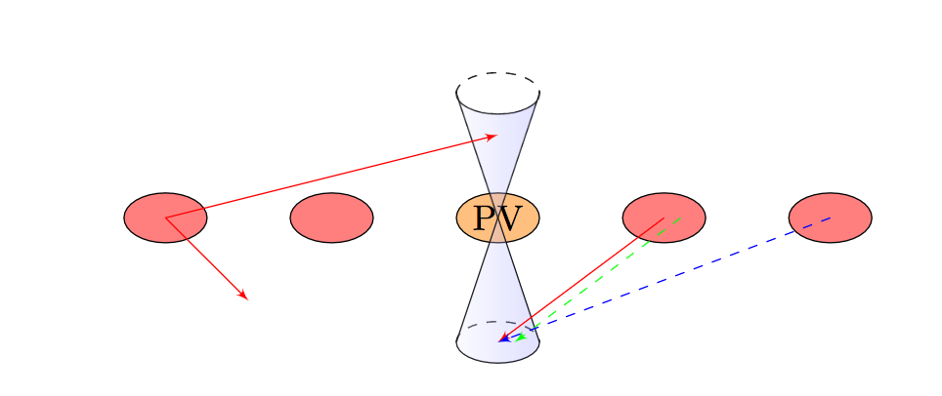
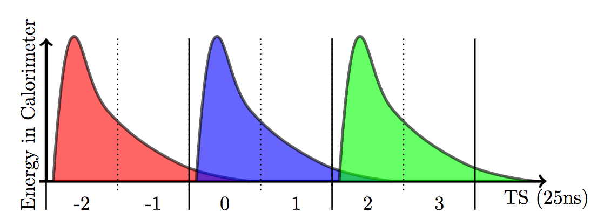
More data comes at a cost: Higher Pileup
LHC circulates protons in several very closely packed bunches.
Every bunch crossing, more than one proton-proton collision takes place causing ‘pileup’
Two categories of pileup:
In-time pileup : causes energy from other softer scattering interactions in the current bunch crossing to be integrated into objects in the event
Out-of-time pileup: causes energy from from previous bunch crossings to be integrated into current event.
In-time pileup illustration
Out-of-time pileup illustration
Several methods used to mitigate pileup:
Detector level techniques, primarily reduce OOT pileup, by reducing integration time
Software Level Tools such as Hybrid Jet Area algorithm, Charged Hadron Subtraction

Slide 9
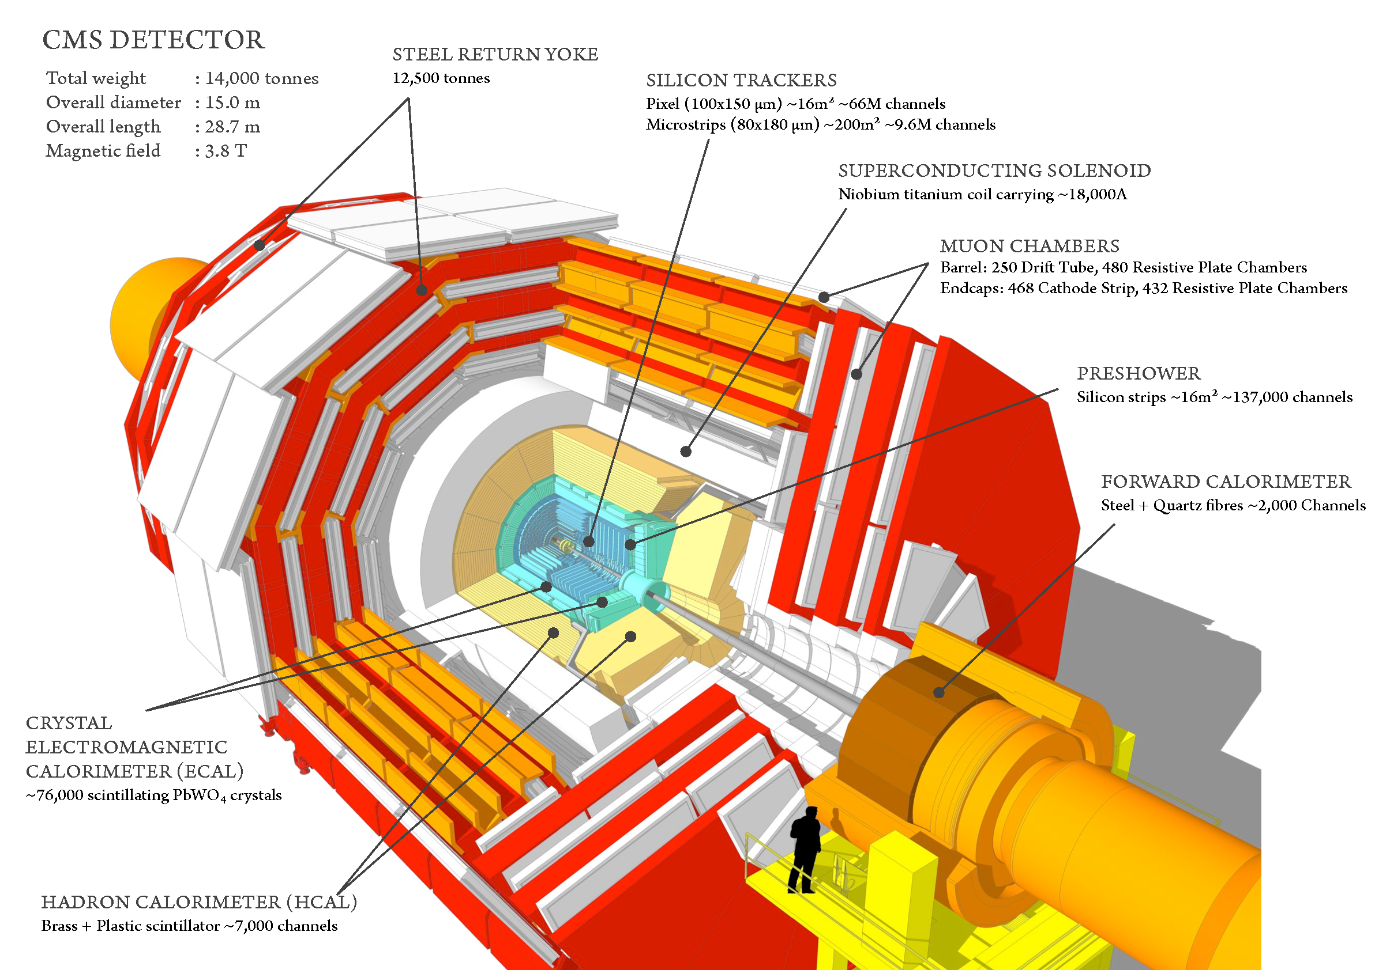
The Compact Muon Solenoid
Large general purpose detector
21.6 m long, 7.5 m radius, ~14,000 tons
Built in layers in and around a giant solenoid magnet (3.8 T field)
Inside the magnet:
Silicon pixel and strip tracker :
measures charged particle trajectories
Lead Tungstate electromagnetic
calorimeter: measures energies of electrons and photons
Brass/Scintillator Hadronic
calorimeter: measures energies of heavier particles
Outside the magnet: Muon Systems: consist of 3 kinds of gas ionization detectors placed in the steel yoke of the magnet . They measure the trajectory of muons.

Slide 10
Dataset and MC Samples
Dataset: 20.1/fb golden JSON data collected in 2016 (Run B/C/D/E/F)
SingleMuon dataset used for both μτ channels
SingleElectron dataset used for eτ channels
Signal events simulated using pythia8
Drell-Yan and Wjets: Madgraph samples inclusive and exclusive binned in number of jets)
Process | Sample Name | Cross-section (pb)
LFV Signal (μτ) | GluGlu_LFV_HToMuTau_M125_13TeV_powheg_pythia8 VBF_LFV_HToMuTau_M125_13TeV_powheg_pythia8 | 44.14* 3.782
LFV Signal (eτ) | GluGlu_LFV_HToMuTau_M125_13TeV_powheg_pythia8 VBF_LFV_HToMuTau_M125_13TeV_powheg_pythia8 | 44.14* 3.782
SM Higgs | GluGluHToTauTau_M125_13TeV_powheg_pythia8 VBFHToTauTau_M125_13TeV_powheg_pythia8 | 44.14 ( Updated to Yellow Report 4,2016) 3.782
WJets | Wjets(1234Jets)ToLNu_TuneCUETP8M1_13TeV-madgraphMLM-pythia8 | 61526; 11670.0; 3804.8; 1155.3; 587.6
DYJets | DYJets(1234Jets)ToLL_M-50_TuneCUETP8M1_13TeV-madgraphMLM-pythia8 | 5765.4 ;1178.24; 386.04 ; 118.08;63.56;
TTJets | TT_TuneCUETP8M1_13TeV-powheg-pythia8 | 831
WW | WW_TuneCUETP8M1_13TeV-pythia8 | 118.7
WZ | WZ_TuneCUETP8M1_13TeV-pythia8 | 47.13
ZZ | ZZ_TuneCUETP8M1_13TeV-pythia8 | 16.523
Single Top | ST_tW_antitop_5f_inclusiveDecays_13TeV-powheg-pythia8_TuneCUETP8M1 ST_tW_top_5f_inclusiveDecays_13TeV-powheg-pythia8_TuneCUETP8M1 | 35.6 35.6
Wgamma | WGstarToLNuEE_012Jets_13TeV-madgraph | 11.7
 | WGstarToLNuMuMu_012Jets_13TeV-madgraph | 3.8
 | WGToLNuG_TuneCUETP8M1_13TeV-amcatnloFXFX-pythia8 | 495.36
*We assume SM Higgs cross sections

Slide 11
MC Corrections
Muon POG scale factors:
Muon ID, ISO
After applying PU reweighting
Tracking POG scale factors:
Muon tracking
E/γ POG scale factors:
electron tracking
Data/MC SF equal to 0.90 following TAU POG recommendations for 2016 data
eτ_{h} fake rate scale factors following TAU POG recommendations (between 1.5 and 2.0)
σ minbias: 69.2 mb
Electron ID/ISO scale factors from HTT group
Top Quark P_{T} reweighting
PU Reweighting has been applied
There is known data/MC discrepancy due to inefficiencies cause by HIPs in 2016 A-F datasets (as noted in AN-2016/355 by the HTT group).
Expected to be mitigated in re-reco data. (tracking POG talk)

Slide 12
H->μτ

Slide 13
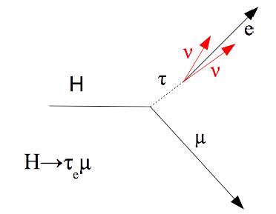
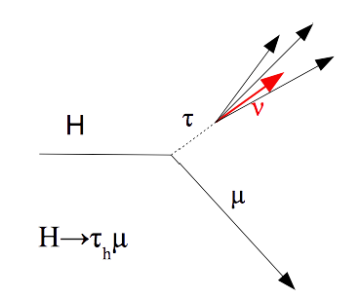
Categories and Channels
Four Categories:
Based on the number of jets with p_{T} > 30 GeV, |η|<4.7 and PF ID loose:
0-Jet and 1-Jet ( dominated by gluon-gluon fusion)
2-jet ( both ggH and VBF events)
The 2-jet category is further divided into two categories based on mass and Δη of the dijet:
2-jet gluon-gluon fusion rich (m_{jj}<550 GeV && Δη_{jj} <3.5)
2-jet VBF rich (m_{jj}>=550 GeV || Δη_{jj} >=3.5)
Two channels per category: electronic and hadronic

Slide 14
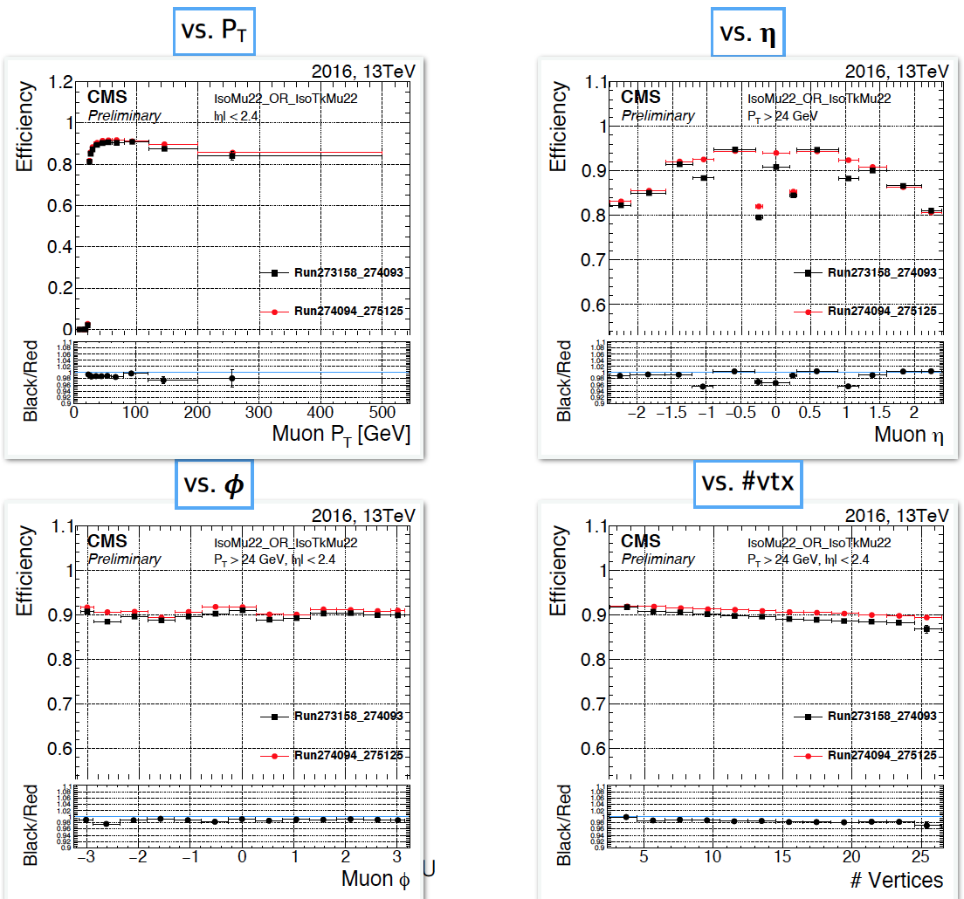
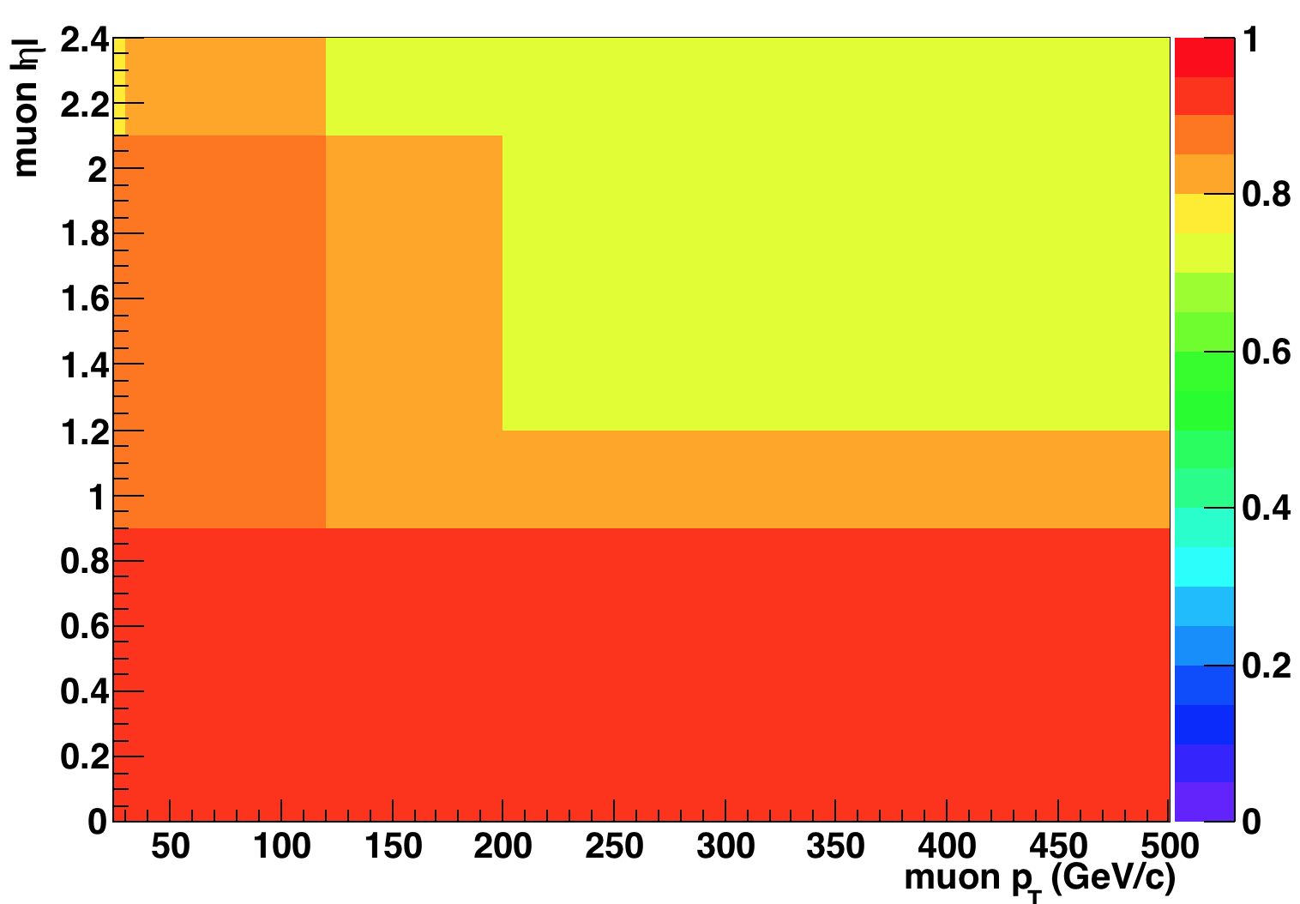
Trigger
HLT paths: HLT_IsoTkMu22 || HLT_IsoMu22
Triggers not emulated in 80X for most MC samples
Trigger efficiency in data is applied to MC in bins of muon p_{T} and absolute η (measured by muon POG)
From K.Lee’s talk at Muon POG, linked here

Slide 15
Mass-reconstruction
Collinear Mass is used as an estimator of Higgs mass.
Collinear approximation: assume neutrino is collinear with tau lepton since it is highly boosted, being much lighter than the Higgs
Visible Mass v/s Collinear Mass after pre-selection cuts
Visible fraction of τ momentum:
<M_{vis}>=95.31 GeV
σ_{Mvis}=14.08 GeV
<M_{coll}>=116.21 GeV
σ_{Mcoll}=18.54 GeV
Collinear Mass of the Higgs:

Slide 16
H->μτ_{e}

Slide 17
Preselection : H →
Opposite Sign Leptons
Electrons
ID: MVA non-Trig WP80
>10 GeV < 2.4 D_{z}<0.2
Isolation: | RelPFIsoDB < 1(loose) RelPFIsoDB < 0.1(Tight)
Cleaning : | Not more than one missing hit PassesConversionVeto ChargeIDTight
Muons
ID: ICHEP medium muon ID
>25 Gev < 2.4 D_{z}<0.2
Isolation: | RelPFIsoDB < 0.25(loose) RelPFIsoDB < 0.15(Tight)
Cleaning : | Has Pixel hits
Other Event Cleaning cuts
ΔR_{μ-e} > 0.3
Btag medium Veto: No b-tagged jet with P_{T}>30GeV
Vetoes: No extra loose muon, electrons or tau leptons

Slide 18
Backgrounds (H ----> μτ_{e} )
DY +jets→ ττ, μμ, ee Normalization and shape from MC simulation Dominant background in 0-jet and 1-jet category
Embedded Z→ττ samples not ready yet.
Misidentified lepton background Estimated using two methods:
W+Jets MC and QCD estimated using data: semi data-driven
Fake rate method: fully data driven
Normalization and shape from MC simulation
Dominant background in 2-jet category
EWK Dibosons + jets
Normalization and shape from MC simulation
W+γ
Normalization and shape from MC simulation
SM Higgs
Normalization and shape from MC simulation
Single top
Normalization and shape from MC simulation

Slide 19
Reducible background : semi data-driven method
W+Jets taken directly from MC
QCD is taken as the difference between data and MC in the LS isolated region, and is scaled by an OS/LS SF equal to 2.30
Similar method used by HTT group
Estimation validated using control region
with inverted muon isolation.(anti-isolated
LS and OS regions)
The factor 2.30 is used in HTT(cf HIG-16-037).
It is measured in events with electrons and
muons passing relaxed isolation cut with an
uncertainty of about 30%
OS
0-jet preselection anti-isolated region
LS
Better Data/MC agreement is currently observed with this method over the fake rate method.

Slide 20
Pre-selection results: semi data-driven method
Reducible background estimated using:
W+jets from MC,
QCD from LS isolated Control
Region
LFV Branching ratio set to 50% for visibility
Gray band : statistical uncertainties and systematic uncertainties added in quadrature
Good Data/MC agreement in all categories
0-jet
1-jet
2-jet gg
2-jet vbf

Slide 21
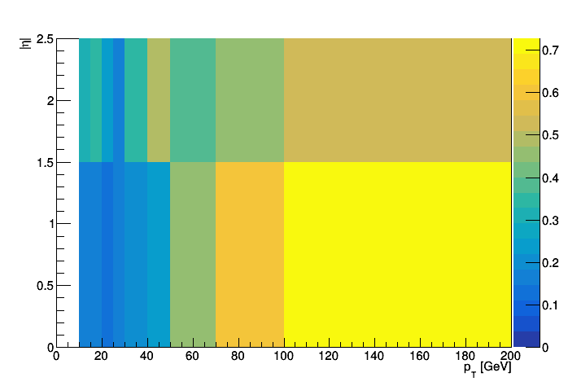
Reducible background : fake-rate method I
Using Z →μμ + X sample, where X is identified as a e, fake-rate factor f_{e} is estimated as :
Simulated Diboson background subtracted
Electron fakerate applied as a function p_{T} and absolute η

Slide 22
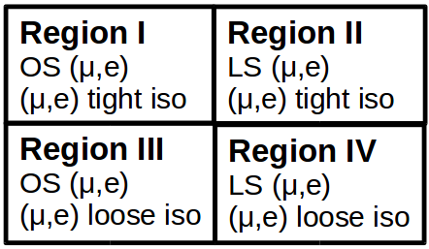
Reducible background : fake-rate method II
Fakes estimated by multiplying a scale factor to region III to obtain fake e in region I
Validated using same procedure in Like Sign regions III and IV
Preselection 0-jet Region II
Data/MC agreement with 40 % norm uncertainty on fakes

Slide 23
Pre-selection results: fake rate method
Reducible background estimated using fake rate
LFV Branching ratio set to 50% for visibility
Gray band : statistical uncertainties and systematic uncertainties added in quadrature
Reasonable Data/MC agreement in all categories
0-jet
1-jet
2-jet gg
2-jet vbf

Slide 24
Signal Selection (H ----> μτ_{e})
Variable | FINAL SELECTION CUTS
 | 0 | 1 | 2-jets GG | 2-Jets VBF
(GeV) > | 30 | 25 | 25 | 25
(GeV) > | 10 | 10 | 10 | 10
(GeV) > | 60 | 40 | 15 | 15
< | 0.7 | 0.7 | 0.5 | 0.3
> | 2.5 | 1 | --- | ---
Cuts have been optimized by checking the limits. Procedure explained in previous talk here

Slide 25
Systematics:(H ----> μτ_{e})
Systematic Uncertainty
Muon Trigger/Id/Isolation | 2%
Electron Id/Isolation | 2%
b-tagging veto | 3%
Luminosity | 6.2%
Theory Uncertainty | 10%
Z → | 10%
WW,ZZ ,WZ background | 5%
W + Jets background | 10%
background | 6%
W + γ | 10% ⊕ 5%
Single top production background | 5%
QCD | 30%
Reducible BG (fakerate method) | 40%
Jet Energy Scale | ± σ
Unclustered Energy Scale | ± σ
Electron Energy Scale | To be added
Muon Energy Scale | To be added
btag shape | To be added
Shape Uncertainties applied for
Jet Energy Scale
Unclustered Energy Scale
Vary by
Bin-by-Bin Uncertainty applied
Overall uncertainty of 3% applied on b-tagging veto
Number following ⊕ is uncorrelated between categories

Slide 26
Final Selection Plots: semi data-driven method
LFV Branching ratio set to 10% for visibility
Limits and significance at 20.1/fb
 | 0 | 1 | 2-gg | 2-vbf | Combined
Limits | 1.410 | 1.711 | 3.766 | 1.930 | 0.887
Significance | 1.335 | 1.054 | 0.538 | 0.588 | 1.899

Slide 27
Final Selection Plots: fake rate method
0-jet
1-jet
2-jet gg
2-jet vbf
LFV Branching ratio set to 10% for visibility
Limits and significance at 20.1/fb
 | 0 | 1 | 2-gg | 2-vbf | Combined
Limits | 1.285 | 1.961 | 4.047 | 2.117 | 0.910
Significance | 1.481 | 0.995 | 0.482 | 1.014 | 2.14

Slide 28
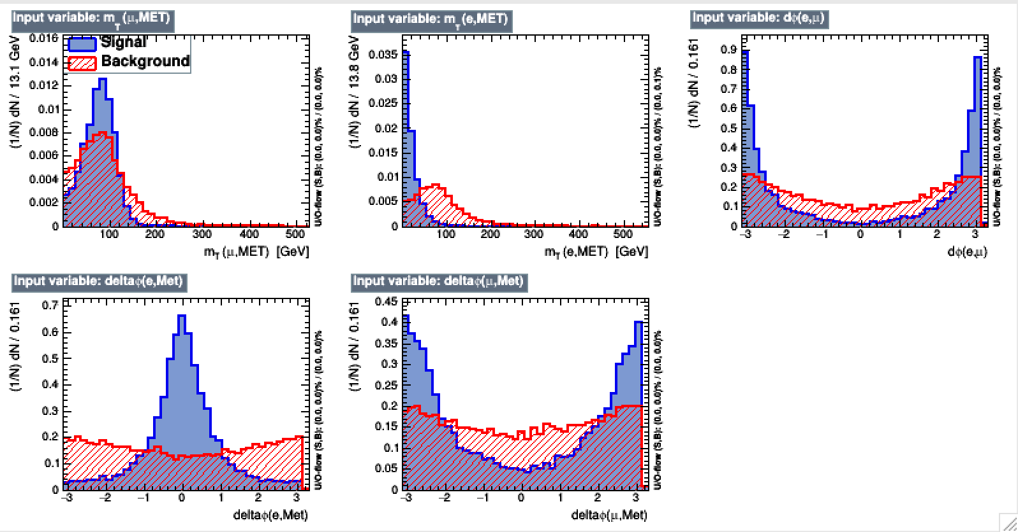
BDT
BDT trained against ttbar background:
Large statistics
Dominant background in 2-jet categories and significant 1jet category
Shares several kinematic characteristics with other backgrounds such as diboson, single top
Discrimination against DY from fit on collinear mass
Input variables:
m_{T}(μ,MET)
m_{T}(e,MET)
Δφ(e, μ)
Δφ(e,MET)
Δφ(μ,MET)

Slide 29
BDT: MVA output distribution
0-jet
1-jet
BDT efficient against ttbar,Dibosons, single top,W+γ
backgrounds
LFV Branching ratio set to 50% for visibility
Gray band : statistical uncertainties and systematic uncertainties added in quadrature
Good Data/MC agreement in all categories
2-jet vbf
2-jet gg

Slide 30
M_{coll} distributions: after cut on BDT
LFV Branching ratio set to 10% for visibility
Limits and significance at 20.1/fb
 | 0 | 1 | 2-gg | 2-vbf | Combined
BDT cutsvalue > | 0.18 | 0.08 | 0.01 | 0.04 | --
Limits | 1.356 | 1.938 | 5.000 | 1.712 | 0.887
Significance | 1.368 | 0.919 | 0.413 | 1.216 | 2.16

Slide 31
Limit comparison: Different BDTs v/s cut-based
BDT1: trained on ttbar (shown on last 3 slides) – fit on collinear mass
BDT2: train two separate BDTs- one for 0-1 jet category (against DY+ttbar), another for 2 jet category (against ttbar)- fit on collinear mass
BDT3:trained against ttbar+DY, but with collinear mass variable added to input list
-fit on BDT
 | 0 | 1 | 2-gg | 2-vbf | Combined
Cut-based | 1.410 | 1.711 | 3.766 | 1.930 | 0.887
BDT1 | 1.356 | 1.938 | 5.000 | 1.712 | 0.887
BDT2 | 1.215 | 1.898 | 4.2656 | 2.028 | 0.895
BDT3 | 1.051 | 1.586 | 2.805 | 1.465 | 0.713
Similar performance as cut based achieved from BDT1 and BDT2. BDT3 gives 20% improvement on limits, but hard to interpret visually.

Slide 32
H->μτ_{h}

Slide 33
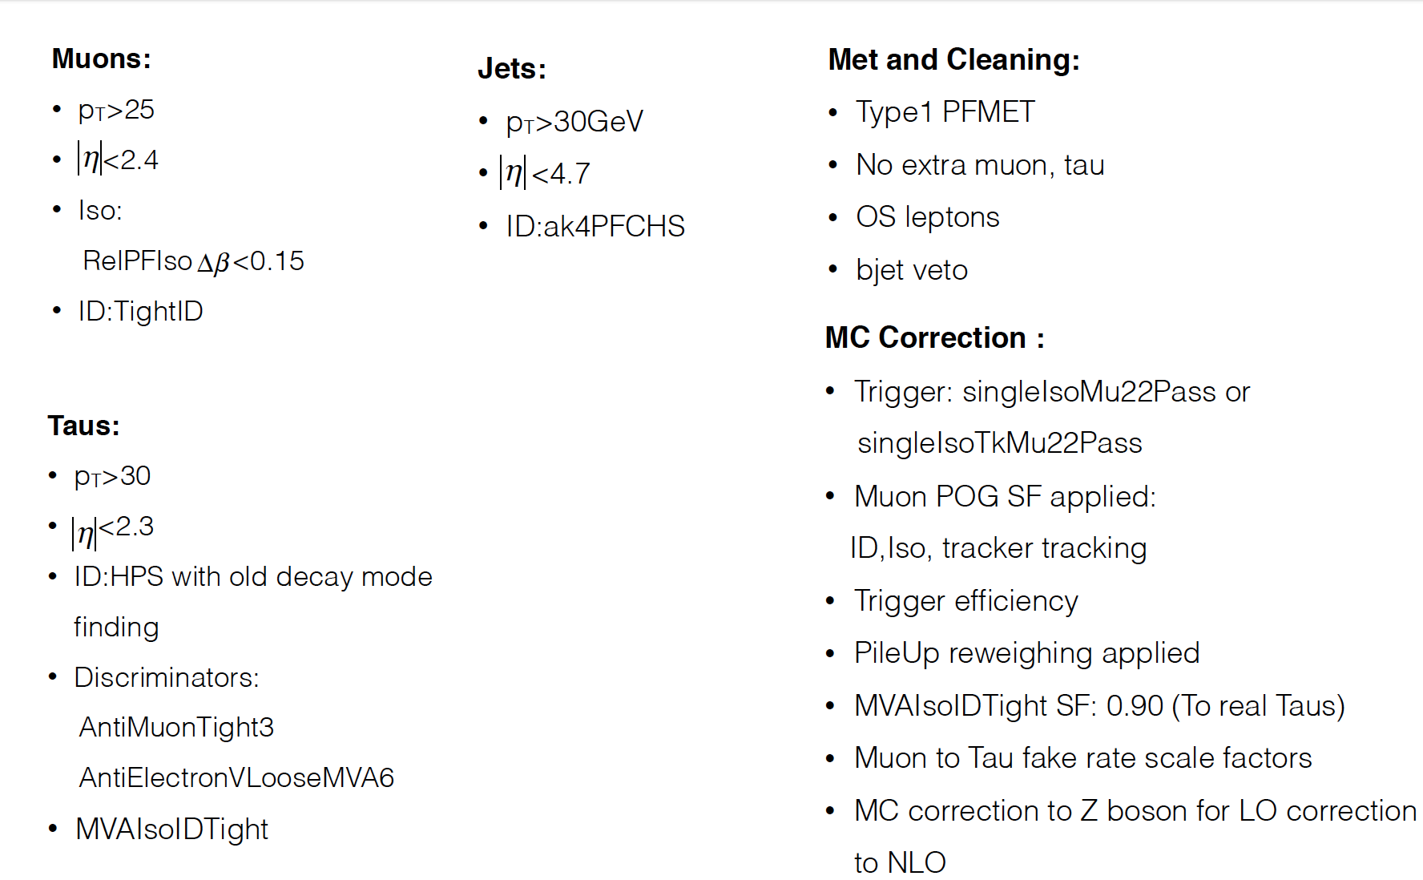
Preselection : H → μτ_{h}

Slide 34
Backgrounds (H ----> μτ_{h} )
Z→ ττ Normalization and shape from MC simulation
Embedded Z→ττ samples not ready yet.
DY +jets→ μμ, ee Normalization and shape from MC simulation
Misidentified lepton background Estimated using fully data-driven fake rate method Dominant background
Normalization and shape from MC simulation
Dominant background in 2-jet category
SM Higgs
Normalization and shape from MC simulation
EWK Dibosons + jets
Normalization and shape from MC simulation
Single top
Normalization and shape from MC simulation

Slide 35
Reducible background μτ_{h} : fake-rate method I
Using Z →μμ + X sample, where X is identified as a τ, fake-rate factor f_{τ} is estimated as :
Simulated diboson background subtracted
Tau fakerate applied as a function of tau decay mode

Slide 36
Reducible background : fake-rate method II
Fakes estimated by multiplying a scale factor to region III to obtain fake e in region I
Validated using same procedure in Like Sign regions III and IV
Preselection 0-jet Region II
Data/MC agreement with 30 % norm uncertainty on fakes

Slide 37
Pre-selection results: μτ_{h}
Reducible background estimated using fully data driven fakerate method
Gray band : statistical uncertainties and systematic uncertainties added in quadrature
Good Data/MC agreement in all categories
0-jet
1-jet
2-jet

Slide 38
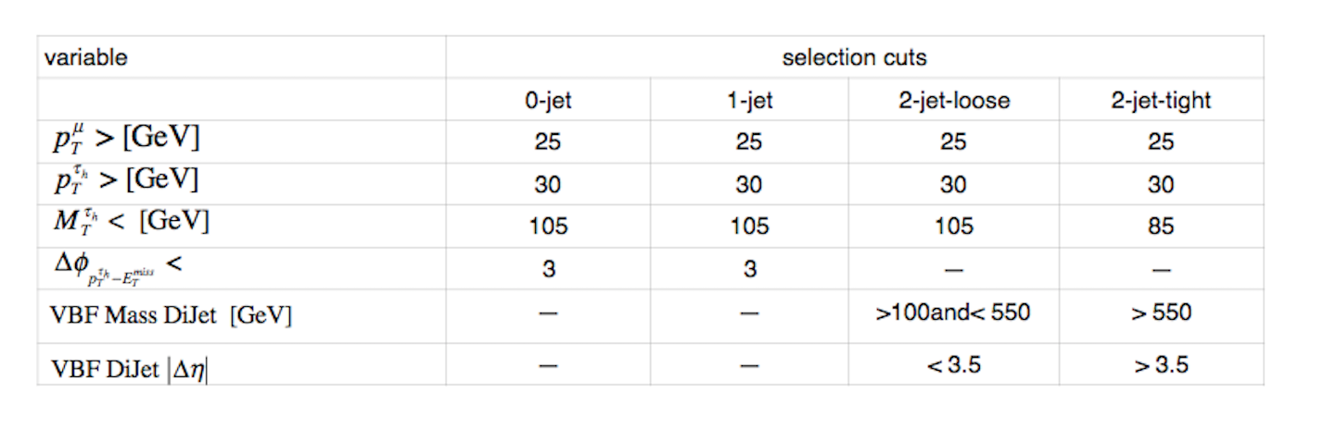
Signal Selection (H → μτ_{h})
Cuts have been optimized by checking the limits. Procedure explained in previous talk here
Lower 100 GeV cut on on 2-jet invariant mass category in 2-jet loose category. The events in 2-jet loose which have an invariant mass less than 100 GeV are put into 1-jet category.

Slide 39
Systematics:(H → μτ_{h})
Shape Uncertainties applied for
Jet Energy Scale
Unclustered Energy Scale
Tau Energy scale
Misidentified tau shape
Vary by
Systematic Uncertainty
Muon Trigger/Id/Isolation | 2%
Electron Id/Isolation | 2%
b-tagging veto | 3%
Luminosity | 6.2%
Theory Uncertainty | 10%
Z → | 10%
WW,ZZ ,WZ background | 5%
W + Jets background | 10%
background | 6%
Single top production background | 5%
Reducible BG (fakerate method) | 30%
Jet Energy Scale | ± σ
Misidentified Tau shape | ± σ
Unclustered Energy Scale | ± σ
Tau Energy Scale | ± σ
Muon Energy Scale | To be added
Bin-by-Bin Uncertainty applied
Overall uncertainty of 3% applied on b-tagging veto
Number following ⊕ is uncorrelated between categories

Slide 40
Final Selection Plots: fake rate method
0-jet
1-jet
2-jet gg
2-jet vbf
Expected limits and significance at 20.1/fb
 | 0 | 1 | 2-gg | 2-vbf | Combined
Limits | 1.65 | 1.68 | 3.09 | 1.59 | 0.86
Significance | 1.18 | 1.08 | 0.64 | 1.29 | 2.25

Slide 41
Review of H->eτ
*Details in in talk here and backup.

Slide 42
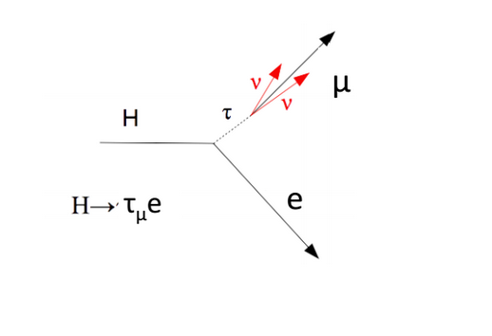
Categories and Channels
Analogous to H→μτ
Four Categories:
Based on the number of jets with p_{T} > 30 GeV, |η|<4.7 and PF ID loose:
0-Jet and 1-Jet ( dominated by gluon-gluon fusion)
2-jet ( both ggH and VBF events)
The 2-jet category is further divided into two categories based on mass and Δη of the dijet:
2-jet gluon-gluon fusion rich (m_{jj}<550 GeV )
2-jet VBF rich (m_{jj}>=550 GeV )
Two channels per category: electronic and hadronic
e

Slide 43
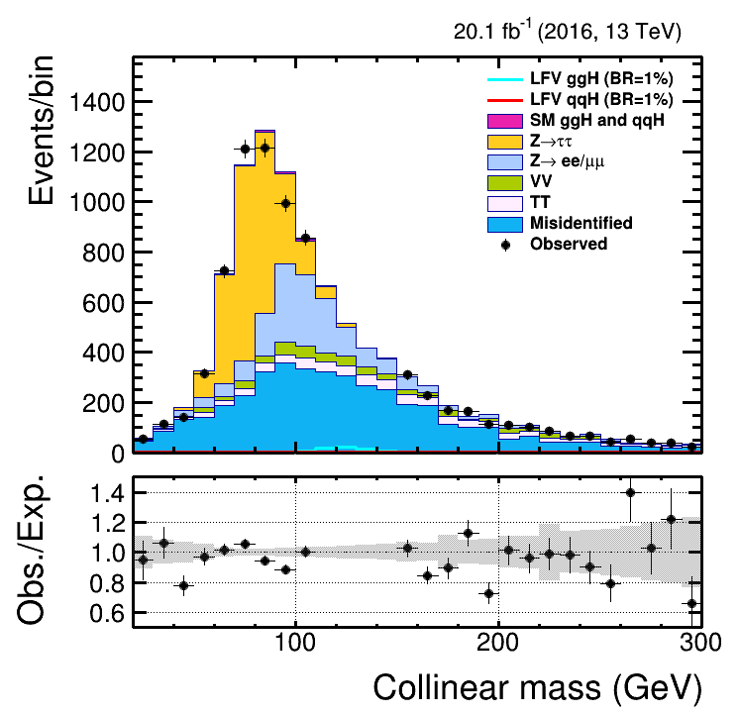
Background: eτ_{h}
Z→ττ: taken from Madgraph MC, with stitched exclusive (DY1(2/3/4)Jets) and inclusive samples
Other Drell-Yan: Z→ll and events where a jet fakes the τ_{h}
ttbar: from Powheg MC, top p_{T} reweighting applied
SM Higgs: ggH and qqH with H→ττ
Diboson: includes WW, WZ, ZZ, and single top
Reducible: estimated with fake rate method (dominant background)

Slide 44
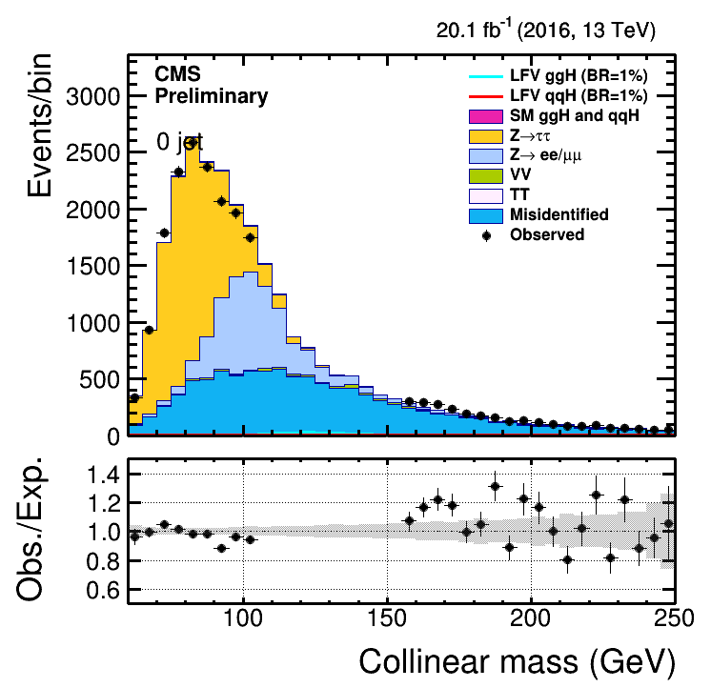
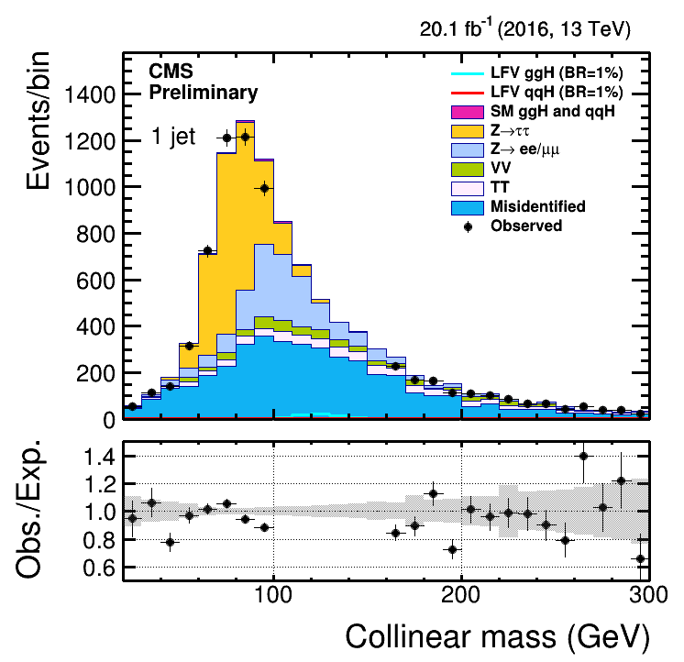
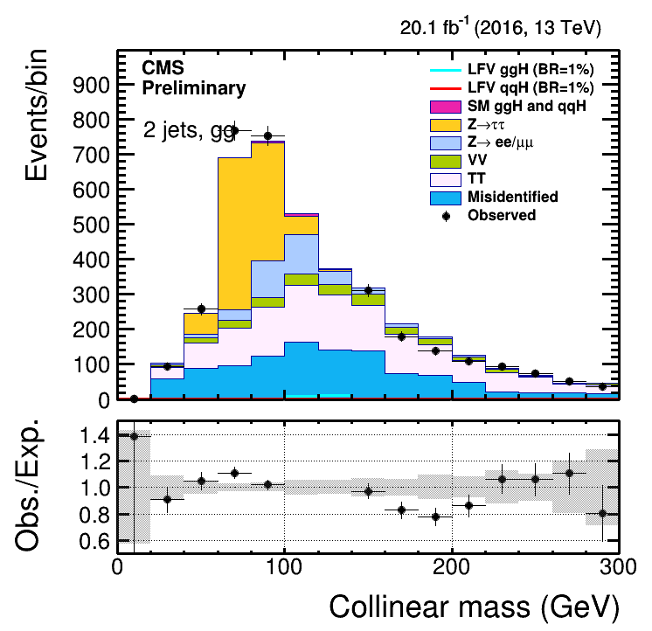
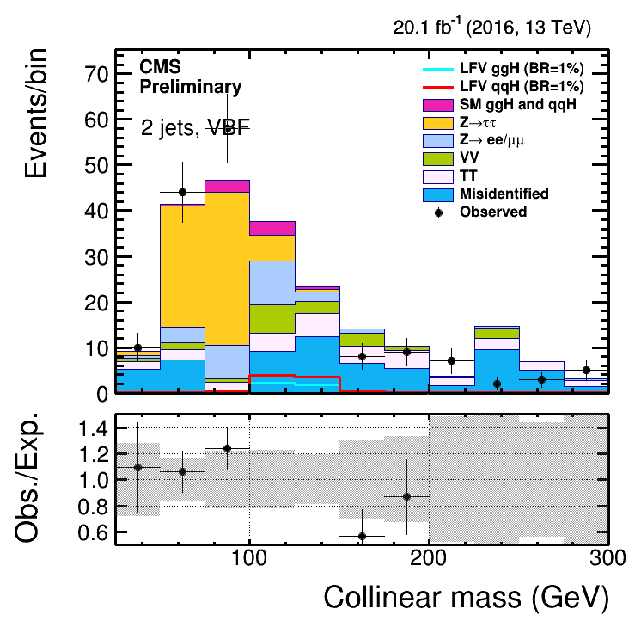
Distributions after final selection: eτ_{h}
Good data/MC agreement
Large weights for the reducible background (visible in last plot)
Only statistical uncertainty drawn

Slide 45
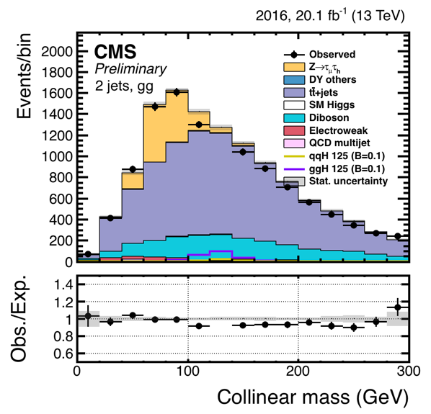
Backgrounds: eτ_{μ}
Z→ττ: taken from Madgraph MC, with stitched exclusive (DY1(2/3/4)Jets) and inclusive samples (dominant in 0 and 1-jet)
Other Drell-Yan: Z→ll and events where a jet fakes the τ_{h}
ttbar: from Powheg MC, top p_{T} reweighting applied (dominant in 2-jet)
SM Higgs: ggH and qqH with H→ττ
Diboson: includes WW, WZ, ZZ, and single top
QCD: from SS data
W+jets: from MC stitched samples

Slide 46
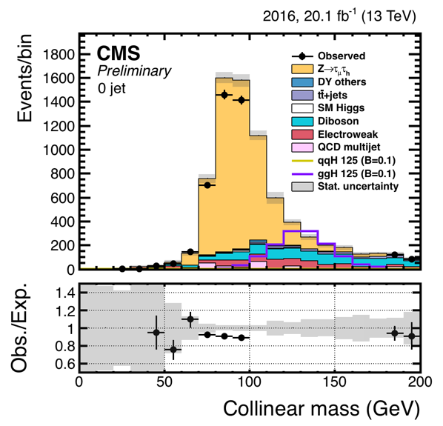
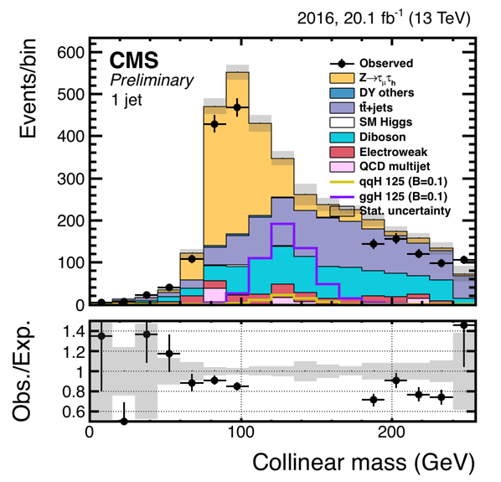
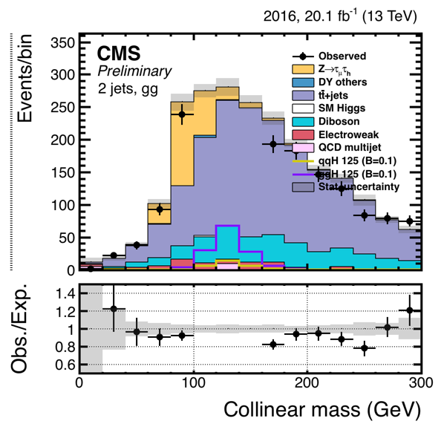
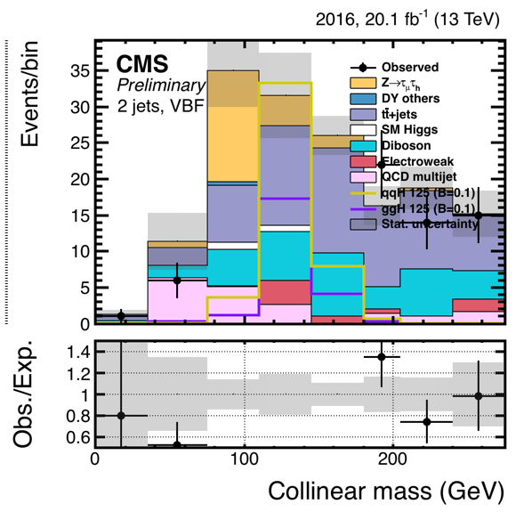
Final selection plots: eτ_{μ}
Good data/MC agreement in all categories
Only statistical uncertainty drawn

Slide 47
Limits: eτ
 |  | 0 | 1 | 2-gg | 2-vbf | Combined
eτ_{h} |  | 0 jet | 1 jet | 2 jets gg | 2 jets vbf | Combined
 | Cut-based | 1.85 | 2.44 | 4.45 | 2.24 | 1.16
 | Cut on BDT, fit on M_{coll} | 1.9 | 2.13 | 3.83 | 1.52 | 0.98
 | Fit on BDT (M_{coll in input)} | 0.87 | 1.43 | 2.38 | 1.07 | 0.56
eτ_{e} |  | 0 jet | 1 jet | 2 jets gg | 2 jets vbf | Combined
 | Cut-based | 1.16 | 1.9 | 4.89 | 2.8 | 0.9
 | Cut on BDT, fit on M_{coll} | 0.96 | 1.98 | 4.11 | 1.74 | 0.76
 | Fit on BDT (M_{coll in input)} | 0.86 | 1.82 | 3.23 | 1.82 | 0.7
Expected eτ limits on at 20.1/fb

Slide 48
Combined Limits

Slide 49
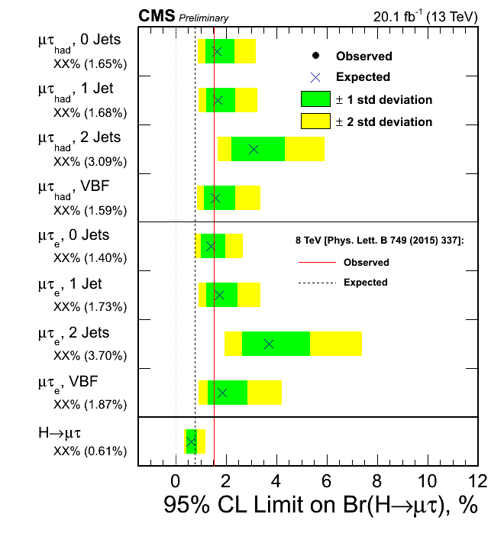
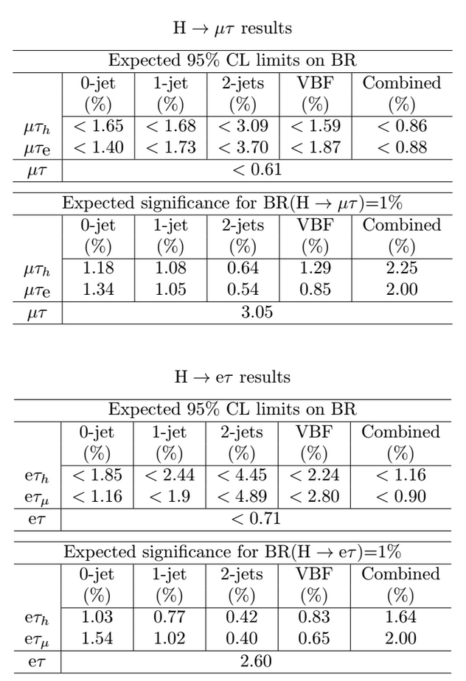
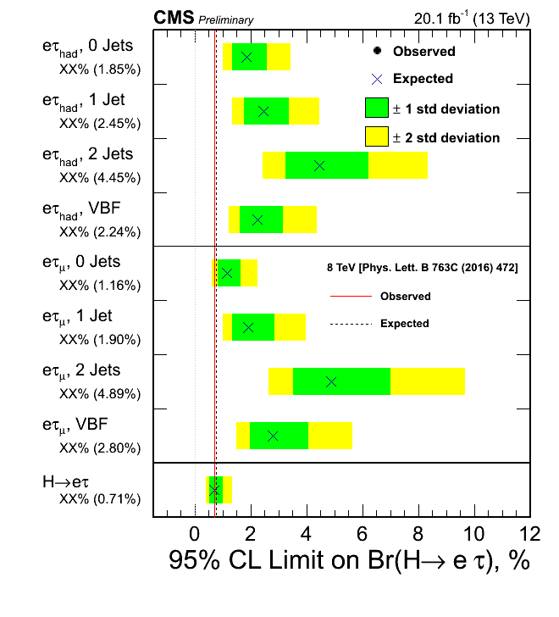
Combined expected limits and significance

Slide 50
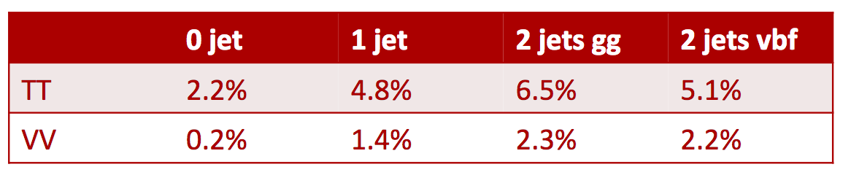
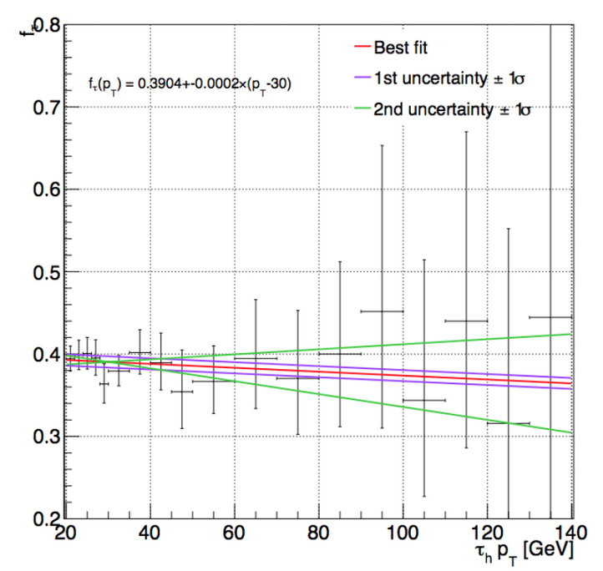
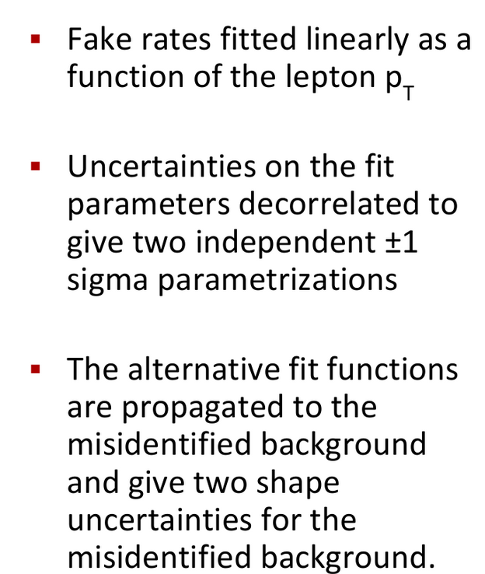
Systematics: Plans
Btag uncertainties in (eμ) calculated: to replace 3% overall uncertainty applied now
Misidentified background shape uncertainty
(negligible in all other backgrounds)

Slide 51
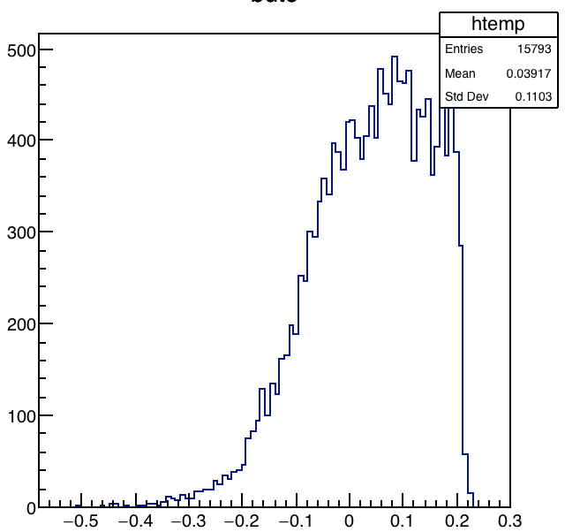
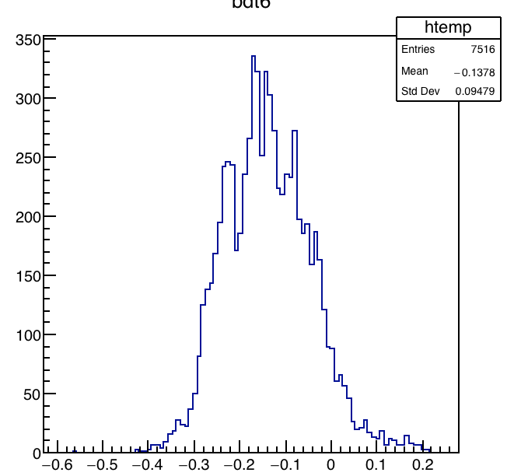
Contamination (I): LFV H→µτ_{e} in H→eτ_{μ}
After the cut-based selection, there is 1 H→µτ_{e} event for 40 to 60 H→eτ_{μ} events depending on the category (assuming same branching fraction). The peaks are both at 125 GeV.
After the BDT-based selection, there is 1 H→µτ_{e} event for about 20 H→eτ_{μ} events (assuming same branching fraction). The peak for µτ events is shifted down by 5 GeV (around 120 GeV).
The BDT distributions for H→µτ_{e} and H→eτ_{μ} events are very different , and the majority of µτ events are rejected (cut at 0)
H→eτ_{μ}
H→µτ_{e}

Slide 52
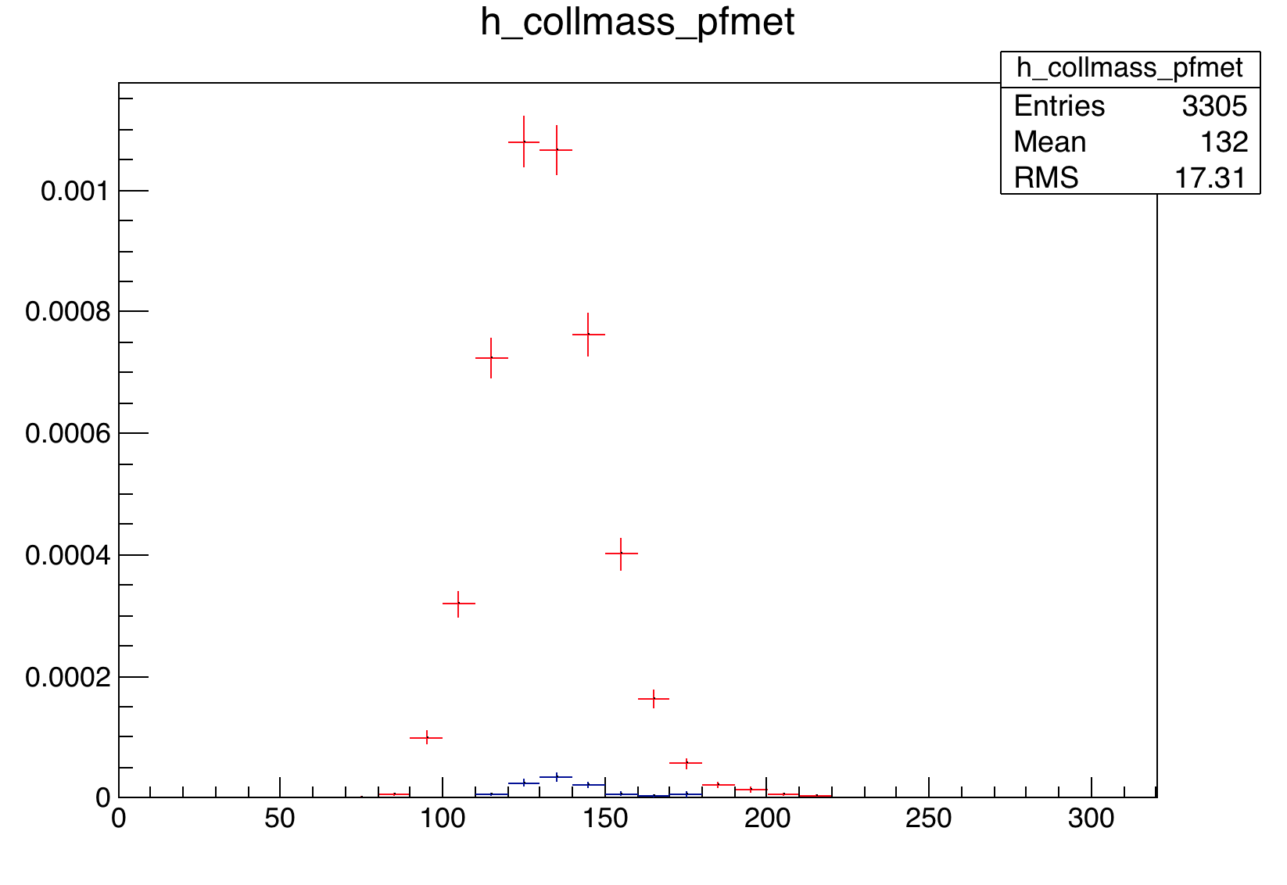
Contamination (II): LFV of H → eτ_{μ} in H → μτ_{e}
52
After the cut-based selection, there is 1 H→eτ_{μ} event for about 10 to 50 H→μτ_{e} events depending on the category (assuming same branching fraction). The peaks are both close to 125 GeV.
Category | H → μτ_{e} | H → eτ_{μ}
0-jet | 50 | 1
1-jet | 25 | 1
2-jet gg-enriched | 11 | 1
2-jet vbf-enriched | 15 | 1
All categories | 25 | 1
Contamination from other channel is reasonably minimal.
125 GeV
N.Dev (University of Notre Dame)
11/21/16

Slide 53
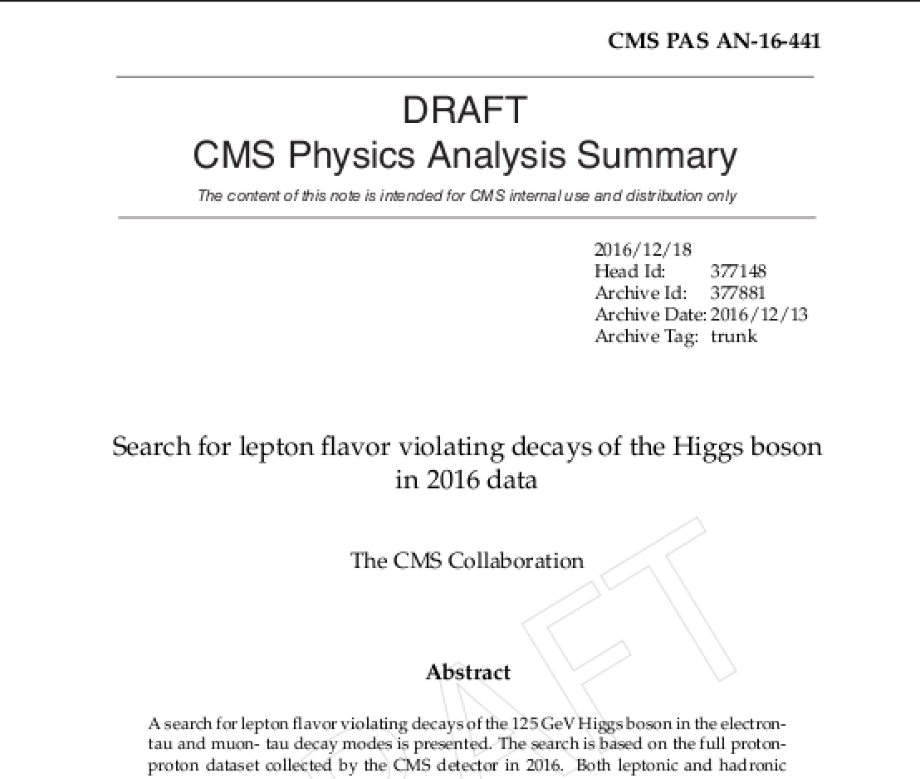
Conclusions
Search for Lepton Flavor Violating Decays of the Higgs Boson at 13 TeV in good shape for both the µτ and eτ final state
Systematics need to be studied in further detail
Documentation is on the way
All channels will be updated to full 2016 dataset soon
Thank you

Slide 54
Back up

Slide 55
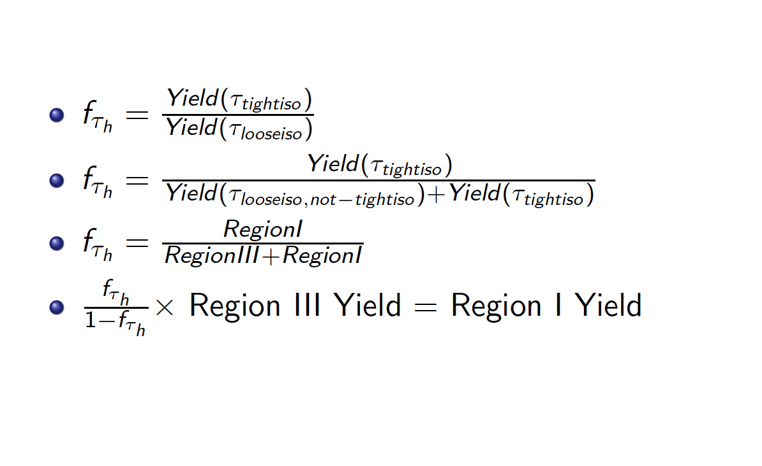
Fake rate algaebra

Slide 56
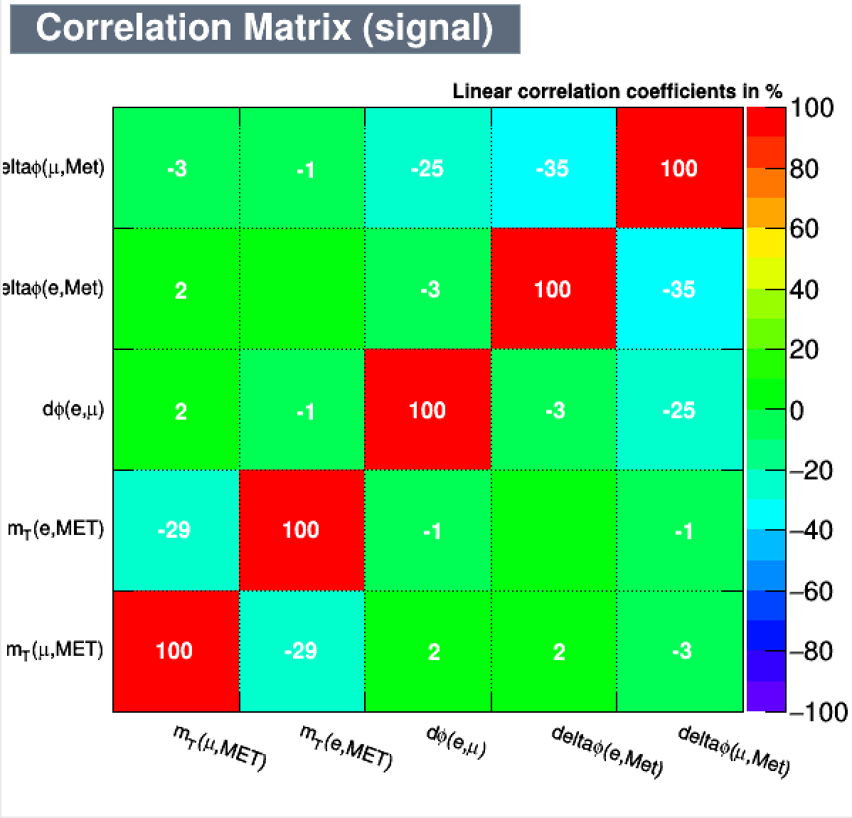
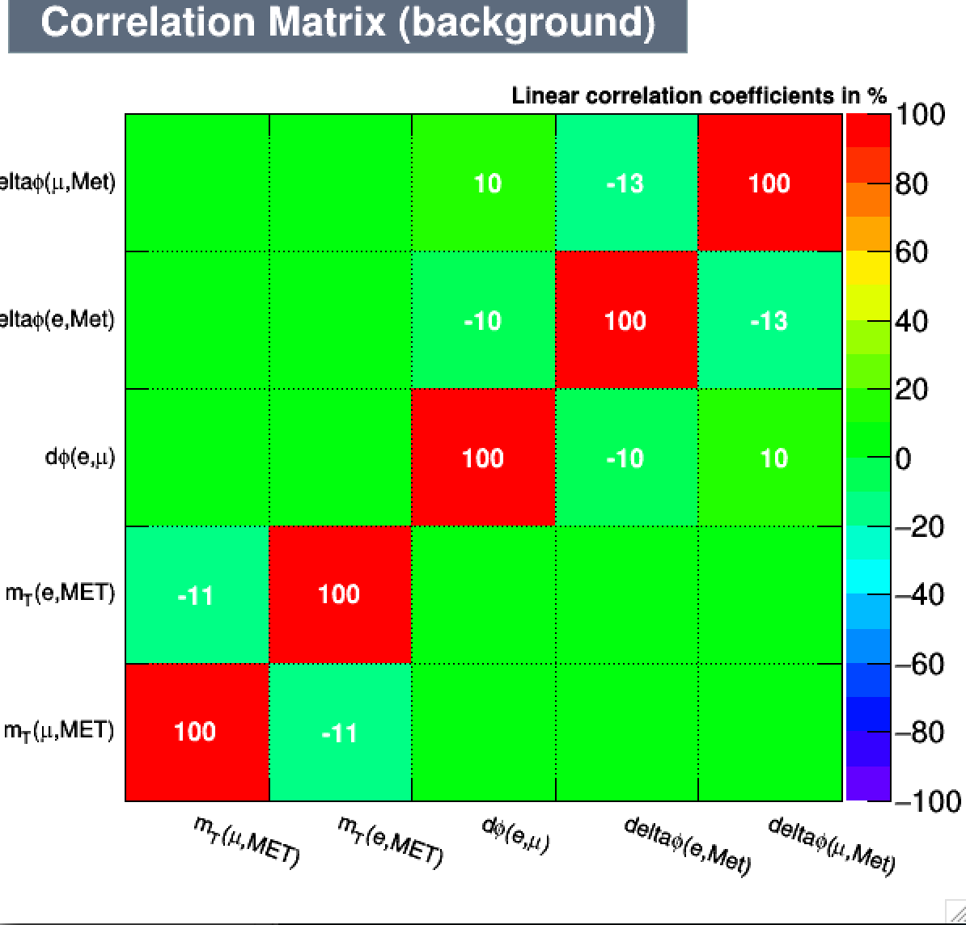
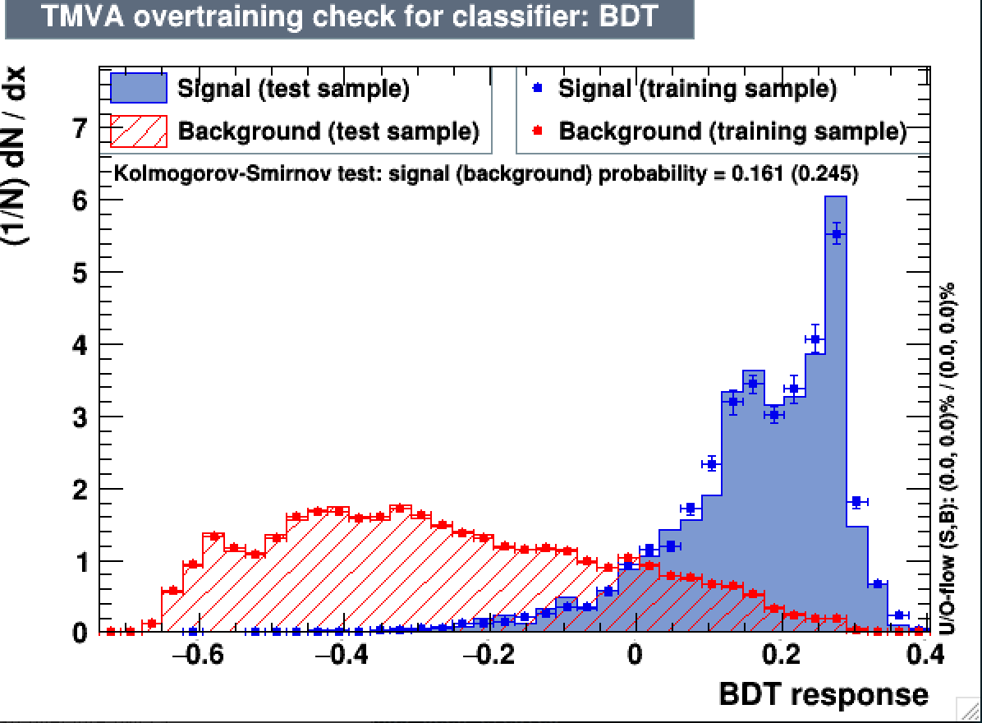
BDT1 :µτ_{e} - variable correlations and overtraining check
Good testing/training matching for background
Reasonable matching for background, given low statistics

Slide 57
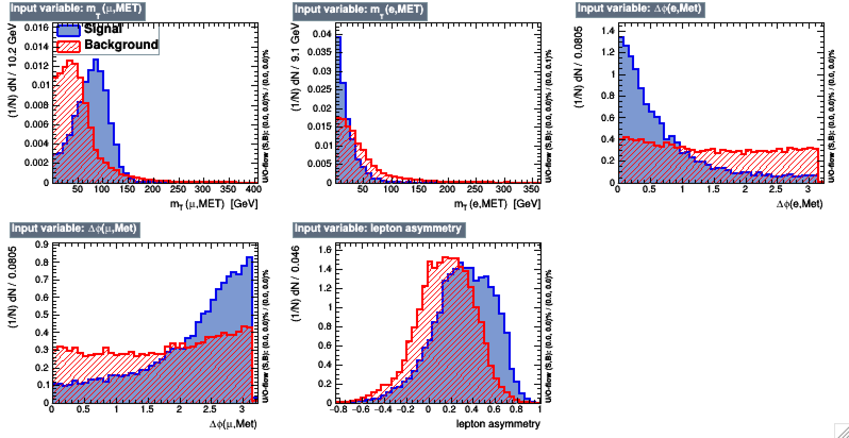
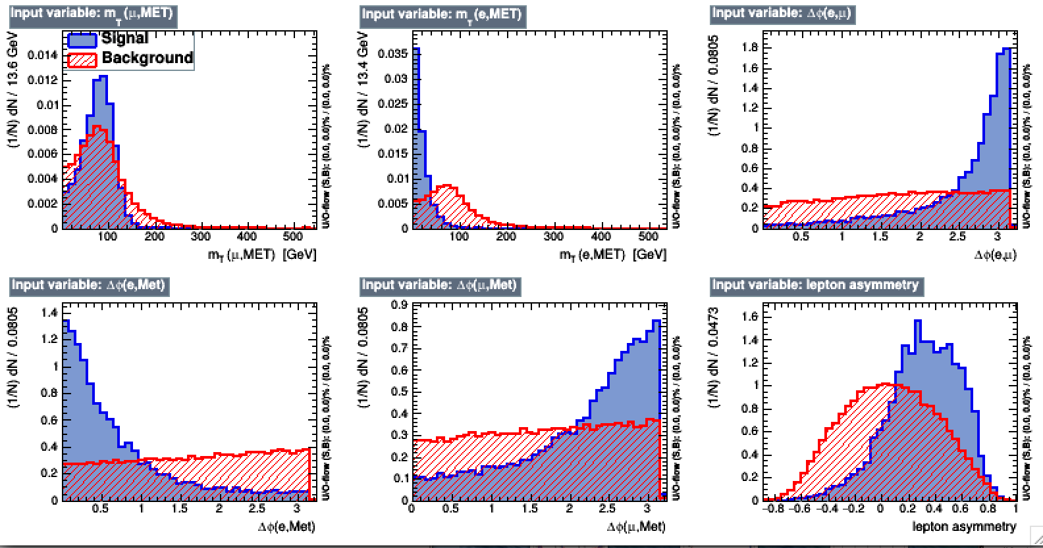
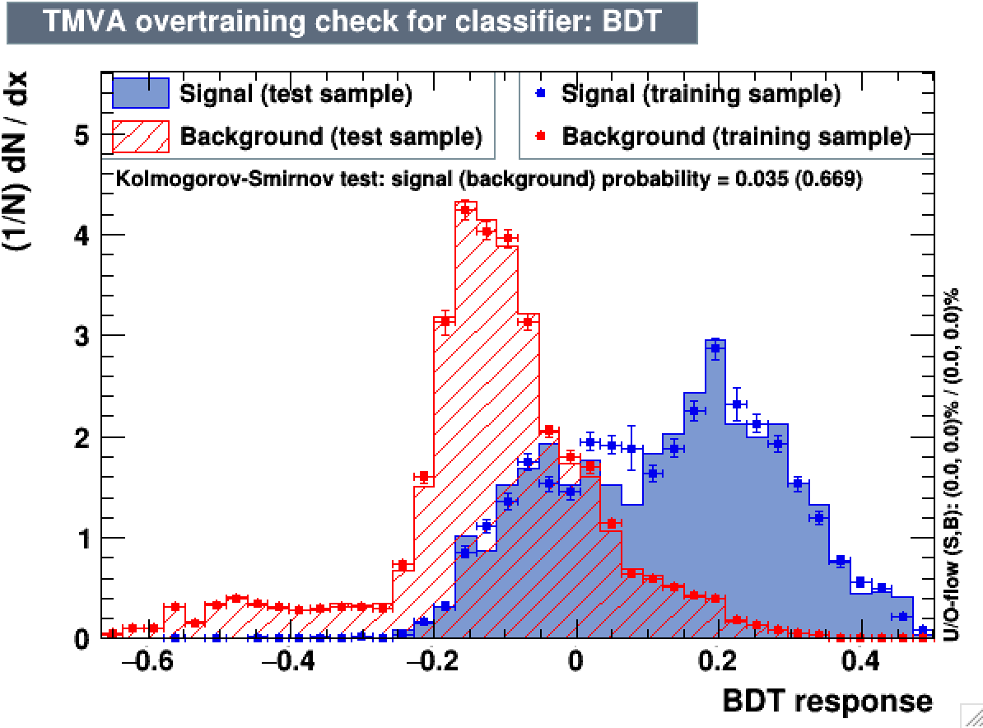
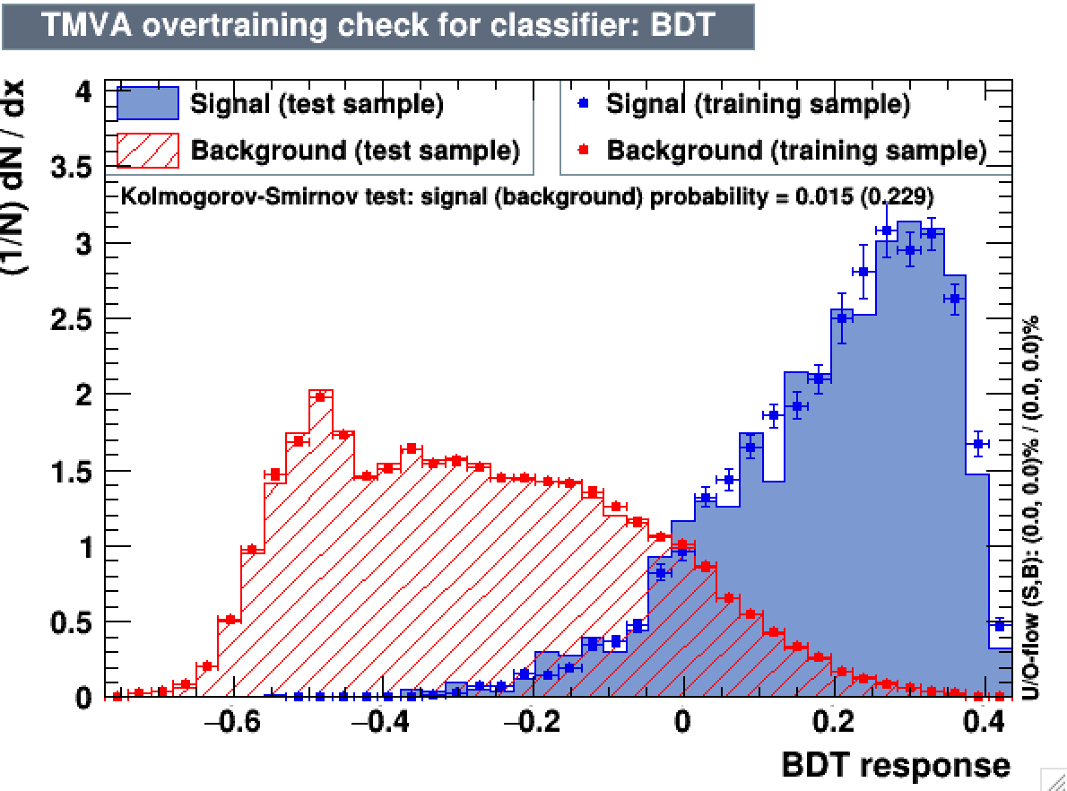
BDT2:µτ_{e} -- Different BDTs for different categories
Train two BDTs
0-jet and 1-jet using DY+TT as background input
2-jet using only TT as background input
 | 0 | 1 | 2-gg | 2-vbf | Combined
Limits | 1.215 | 1.898 | 4.2656 | 1.465 | 0.895
Significance | 1.181 | 0.910 | - | 0.832 | 1.752

Slide 58


BDT3: µτ_{e} -- with collinear mass as input variable
Background trained against: DY +TTBar
 | 0 | 1 | 2-gg | 2-vbf | Combined
Limits | 1.051 | 1.586 | 2.805 | 1.465 | 0.713
Significance | 1.453 | 1.111 | 0.655 | 1.259 | 2.32
Best limits but hard to visualize

Slide 59
H->eτ_{h}

Slide 60
Background: eτ_{h}
Z→ττ: taken from Madgraph MC, with stitched exclusive (DY1(2/3/4)Jets) and inclusive samples
Other Drell-Yan: Z→ll and events where a jet fakes the τ_{h}
ttbar: from Powheg MC, top p_{T} reweighting applied
SM Higgs: ggH and qqH with H→ττ
Diboson: includes WW, WZ, ZZ, and single top
Reducible: estimated with fake rate method (dominant background)

Slide 61
Preselection:eτ_{h}
SingleEle25 trigger (trigger efficiency in data applied to MC)
Electron: pT > 30 GeV, |h| < 2.1, MVA non trig ID WP80, relative isolation < 0.10
Hadronic tau: old decay mode finding, Tight MVA isolation, Tight MVA anti-electron discriminator, Loose cut-based muon discriminator, p_{T} > 20 GeV, |η| < 2.3
Events with additional identified and isolated electrons, muons, or hadronic taus, are rejected
NO bjet veto

Slide 62


Reducible background estimation:eτ_{h}
Jet→τ_{h} fake rate measured in DY+jets →µµ+jets events:
Denominator: Decay mode finding + Vloose MVA ID
Numerator: Denominator + Tight MVA ID
Jet → e fake rate measured in DY+jets →µµ+jets events:
Denominator: MVA non trig ID WP80 + iso < 0.5
Numerator: Denominator + iso < 0.1
Reducible background = (weighted events with a non-isolated e and an isolated τ_{h}) + (weighted events with an isolated e and a non-isolated τ_{h}) – (weighted events with a non-isolated e and a non-isolated τ_{h})
MC contribution subtracted

Slide 63




Reducible background validation: eτ_{h}
Estimation of reducible background in LS events (other cuts identical to signal region)
Estimation of reducible background in OS W+jets enriched region (m_{T}(τ_{h},MET) > 60 GeV && m_{T}(e,MET) > 80 GeV)

Slide 64




Distributions after preselection:eτ_{h}
Good data/MC agreement
Only statistical uncertainty shown in ratio plot

Slide 65



Selection optimization: eτ_{h}
Best expected limits by selecting events with m_{T}(τ_{h},MET) < 60 GeV
No further improvement by cutting also on Δφ(e,τ_{h}), Δφ(τ_{h},MET), or Δη(e,τ_{h})

Slide 66
Distributions after final selection: eτ_{h}
Good data/MC agreement
Large weights for the reducible background (visible in last plot)
Only statistical uncertainty drawn

Slide 67
H->eτ_{μ}

Slide 68
Backgrounds: eτ_{μ}
Z→ττ: taken from Madgraph MC, with stitched exclusive (DY1(2/3/4)Jets) and inclusive samples (dominant in 0 and 1-jet)
Other Drell-Yan: Z→ll and events where a jet fakes the τ_{h}
ttbar: from Powheg MC, top p_{T} reweighting applied (dominant in 2-jet)
SM Higgs: ggH and qqH with H→ττ
Diboson: includes WW, WZ, ZZ, and single top
QCD: from SS data
W+jets: from MC stitched samples

Slide 69
Preselection: eτ_{μ}
SingleEle25 trigger (trigger efficiency in data applied to MC)
Electron: p_{T} > 26 GeV, |η| < 2.1, ID WP80, iso < 0.10, passes conversion veto and charge ID tight, max 1 missing hit
Muon: pT > 10 GeV, |η|<2.4, medium ICHEP ID, iso < 0.15
Muon and electron are OS and separated by at least ΔR=0.3
Muon, electron, and tau vetoes applied
Btag veto applied (jets with p_{T} > 20 GeV passing medium CSV)

Slide 70
Misidentified background:eτ_{μ}
Similar as used in SM H→ττ
W+jets is taken directly from MC (stitched samples)
QCD is taken as the difference between data and MC in the LS isolated region, and is scaled by an OS/LS SF equal to 2.30 (cf HIG-16-037)
Compared to the fake rate method:
+: Better statistical precision/smaller weights
+: Does not rely on a signal-contaminated control region (important signal contamination if tight denominator in fake rate measurement)
+: Better prediction/observation agreement
-: Not fully data-driven method
-: Not similar to the final states with τ_{h}
In any case the reducible background is very small in the eµ final state

Slide 71




Preselection: eτ_{μ}
Good data/MC agreement in the unblinded regions
Only statistical uncertainty shown

Slide 72








Misidentified background:eτ_{μ} fake rate method
Cross-check: The reducible background (W+jets and QCD) can also be measured with the fake rate method
Signal region on top and validation in LS region below
OS
LS

Slide 73






Selection optimization: eτ_{μ}
m_{T}(e,MET) > 60 GeV
Δφ(µ,MET) < 1.0
P_{ζ} > -60 GeV

Slide 74
Final selection plots: eτ_{μ}
Good data/MC agreement in all categories
Only statistical uncertainty drawn

Slide 75
BDT selection: eτ_{μ}
BDT trained against ttbar:
Large statistics available
Dominant background for njets > 1
Shares some kinematic characteristics with other backgrounds: no strong correlation between lepton and met dphi, no strong correlation between electron and muon dphi.
Input variables:
m_{T}(μ,MET)
m_{T}(e,MET)
Δφ(e, μ)
Δφ(e,MET)
Δφ(μ,MET)
P_{Z}

Slide 76




BDT distribution: eτ_{μ}
Good data/MC agreement in the unblinded regions
BDT efficient against ttbar, W+jets, and diboson
Discrimination from DY by fit on m_{coll} after cutting on BDT output

Slide 77
BDT – Expected limits: eτ_{μ}
Best limits obtained with BDT output > 0.00
About 12% improvement compared to cut-based optimization
 | 0 jet | 1 jet | 2jets gg | 2 jets VBF | Combined
BDT > -0.05 | 1.113 | 2.008 | 4.484 | 2.258 | -
BDT > 0.00 | 0.973 | 2.039 | 4.484 | 1.961 | 0.793
BDT > 0.05 | 0.973 | 2.102 | 4.494 | 2.476 | 0.840
BDT > 0.10 | 0.996 | 3.023 | 8.719 | 5.420 | 0.940
Cut-based | 1.113 | 1.898 | 5.85 | 2.882 | 0.902
Systematics on next slide

Slide 78
Systematics (eτ_{μ}and eτ_{h})
Luminosity | 6.2%
Drell-Yan normalization | 10%
Tau ID efficiency | 10%
Electron ID/iso/trigger efficiency | 2%
Muon ID/iso efficiency | 2%
ttbar normalization | 6%
Reducible bkg (fake rate method) | 30%
W+jets | 10%
QCD | 30%
Diboson | 5%
Btag veto | To be determined
e→t_{h} fake rate | 12%
Electron energy scale | Shape (between 1 and 2.5% shift)
Tau energy scale | Shape (3% shift for real taus)
Unclustered energy scale | Shape
Jet energy scale | Shape

Slide 79
BDT – Overtraining check :eτ_{μ}

Slide 80
BDT – Correlations: eτ_{μ}
Low level of correlation between variables

